Slide 1

Mutual Fund NAV Prediction and Portfolio Optimization
Minor Project(MDS-328)
B.Tech and M.Tech Mathematics and Data Science
Department of Mathematics, Bioinformatics and Computer Applications
Presented by:
Khushi Pal (2240401108)
Mentor: Dr. Chandan Kumar Verma

Slide 2
Outlines
Introduction
Objective and Tools
Data Preprocessing
Challenges in Data Cleaning
Model Architecture LSTM
Training Process
Evaluation Metrics for Performance
Optimization Techniques
Top Fund Selection
Comparison with Hybrid Models
Conclusion

Slide 3
Mutual Fund NAV Prediction and Portfolio Optimization
This project focuses on predicting mutual fund NAVs utilizing LSTM modeling and optimizing fund allocation through various advanced techniques
Maximize returns while minimizing portfolio risk with data-driven strategies

Slide 4

Project Objective and Core Technologies
Objective:
Predict future NAVs.
Optimize fund allocation to maximize returns and minimize risk using:
Sharpe Ratio
Mean-Variance Optimization (MVO)
Bayesian Optimization
Tools Used:
Python (Kaggle Environment.)
Libraries: Pandas, Numpy, Matplotlib, Seaborn, Keras, Scikit-learn, Scipy

Slide 5
01
Dataset and Cleaning
NAV Data Collection Process
Dataset:
NAV (Net Asset Value) historical daily data of 25 different mutual funds.
Source:
Downloaded from Investing.com (5 years of daily data for each fund).
Preprocessing Steps:
Handled missing values using linear interpolation
Scaled NAVs, generated 60-day sequences for LSTM input.

Slide 6
Challenges in Data Cleaning
Date Mismatch across Funds:
➔ Different mutual funds had NAV records missing on different dates, causing
misalignment in the time series.
Our Solution:
➔ Instead of forcing a combined dataset, (into one data frame. ) ➔ We handled each fund individually, treating it as a separate time series. ➔ Applied interpolation and forward-filling separately for each fund to preserve data consistency.

Slide 7
02
LSTM Model
The LSTM model was employed for its proficiency in handling sequential data. It uses historical NAV sequences along with the engineered features to predict future NAVs effectively.
Model Architecture
Two LSTM layers with 50 units each
One Dense output layer for NAV prediction
Training Details
Adam optimizer, Mean Squared Error loss
20 epochs, batch size of 32
80/20 train-test split, monitored validation performance

Slide 8
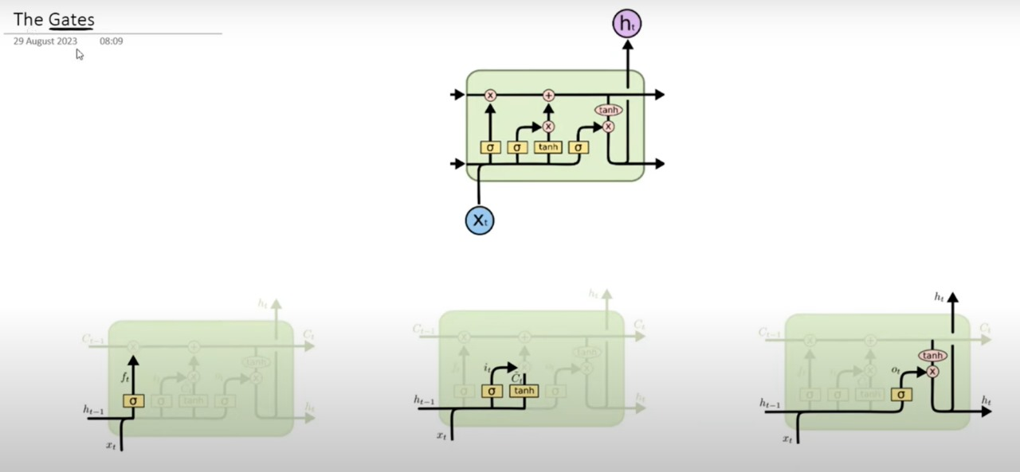
GATES IN LSTM

Slide 9
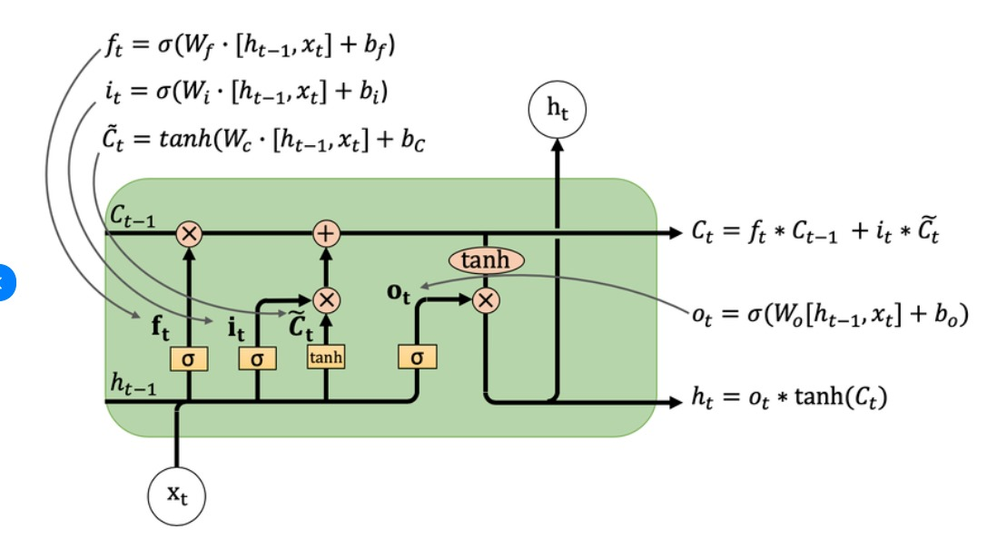
Memory Cells: The LSTM has memory cells that allow it to store information over long time intervals, enabling it to maintain context even in long sequences. This is especially important for understanding sentences or phrases with dependencies across multiple words.
Gates (Input, Forget, Output):
Forget Gate: Decides what information to discard from the cell state, helping the network remove irrelevant or outdated information .
Input Gate: Determines what new information to add to the memory
Output Gate: Controls the information passed to the next layer or the output, which helps in focusing on the relevant parts of the memory

Slide 10
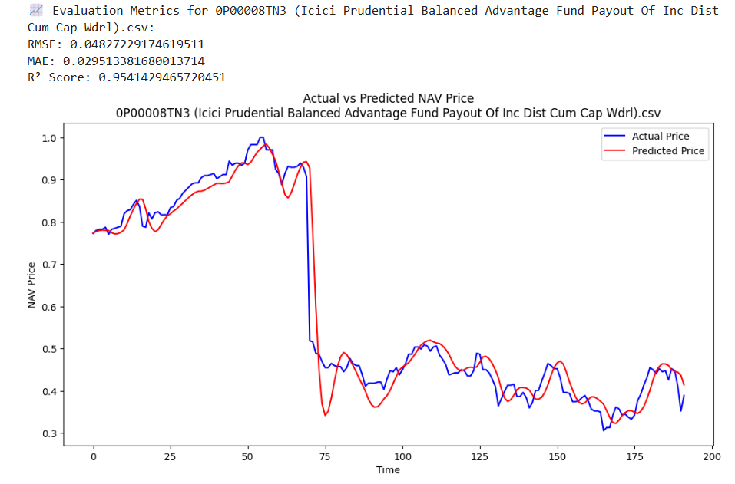
Evaluation Metrics for Performance
The model's performance was rigorously evaluated using Root Mean Square Error (RMSE), Mean Absolute Error (MAE), and R² Score, enabling precise assessment of the model's predictive accuracy.

Slide 11
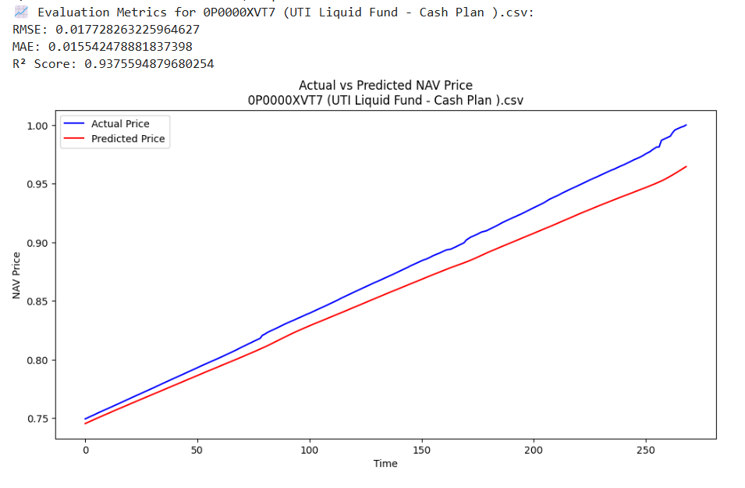
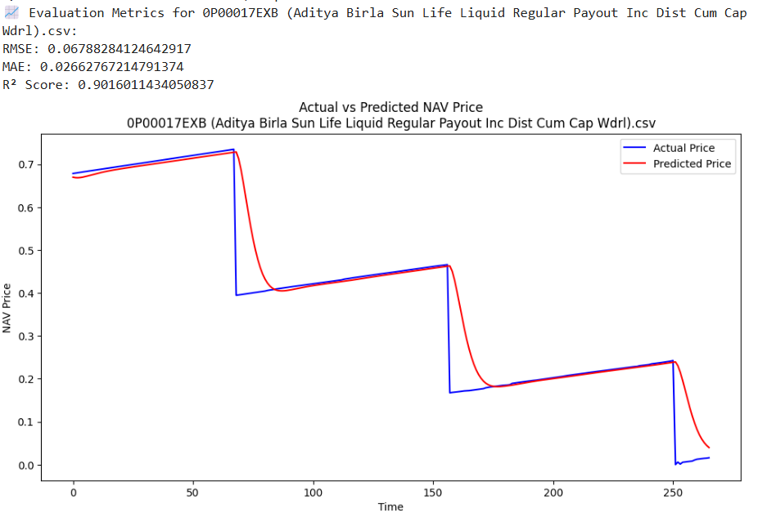
Evaluation Metrics for Performance

Slide 12
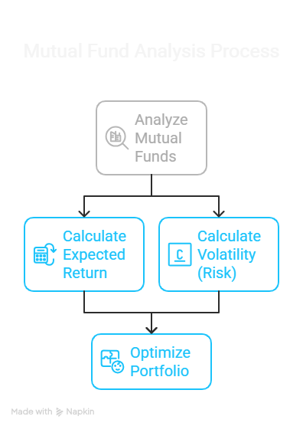
03
Optimization Techniques
Calculation of Expected Return and Volatility for Individual Funds

Slide 13
Mean-Variance Optimization Steps
Mean-Variance Optimization (MVO) employs a mathematical framework for constructing an investment portfolio. The objective is to minimize portfolio variance for a given level of expected return. Steps include calculating expected returns, variances, and covariances of assets, and setting constraints to eliminate short-selling and ensure weights sum to one.
Goal: ➔ Maximize return for a given level of risk, or ➔ Minimize risk for a given level of return.

Slide 14
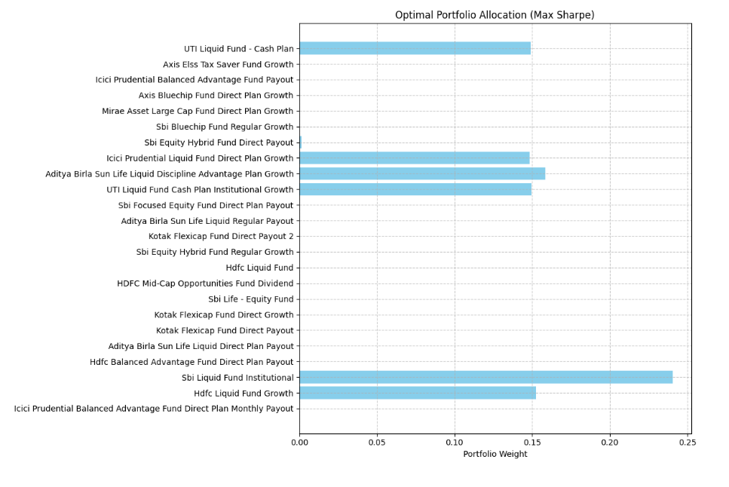
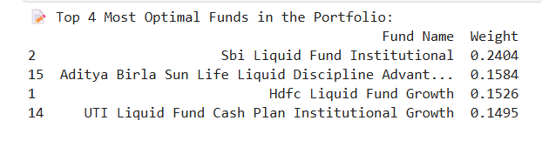
Top Funds
selected the 4 best-performing mutual funds.

Slide 15
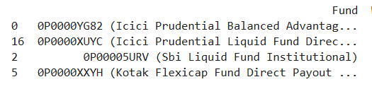
Bayesian Optimization Benefits
Bayesian Optimization is utilized for efficiently locating the optimal portfolio weights. It operates on the principles of sophisticated searching methods and shows superior convergence rates compared to manual or grid search techniques, allowing for better fund weight allocation with limited computational resources.

Slide 16
Comparison with Hybrid Models
We conducted a comparative analysis between the LSTM model and a CNN-LSTM hybrid model, ultimately finding that the pure LSTM model provided superior accuracy and effectively captured sequential patterns.
✅ Observation:
Layered LSTM (stacked LSTM layers) outperformed hybrid CNN-LSTM models on mutual fund datasets.
The simpler sequential structure of Layered LSTM better captured the smooth trends of NAV movements.
📊 Performance Comparison:
Model | RMSE ↓ (Lower Better) | MAE ↓ (Lower Better) | R² Score ↑ (Higher Better)
Layered LSTM | 0.018 | 0.014 | 0.92
CNN-LSTM | 0.024 | 0.019 | 0.87

Slide 17
Inconsistencies in Financial Data
One major challenge was addressing inconsistencies and missing entries in the financial datasets. Rigorous preprocessing steps, including data validation and cleaning operations, were implemented to rectify these issues, ensuring the accuracy of the input data for model training.

Slide 18
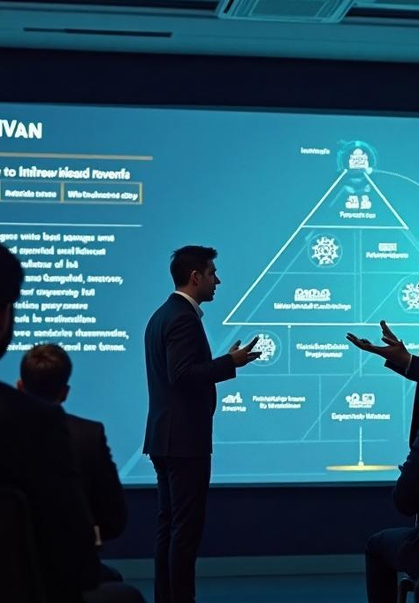
Project Summary
This project successfully integrated advanced predictive modeling with optimization techniques to create a comprehensive framework for mutual fund NAV prediction and portfolio optimization. Future work may include incorporating an attention mechanism and developing an interactive dashboard for enhanced user engagement.

Slide 19
References
Research Papers:
"Predicting Healthcare Mutual Fund Performance Using Deep Learning and Linear Regression" International Journal of Financial Studies
"A Deep Learning Approach for Stock Price Prediction Using LSTM and CNN-LSTM Models" Springer Lecture Notes in Networks and Systems
"Mean-Variance Portfolio Optimization: An Overview" Financial Markets and Portfolio Management Journal
Websites:
Investing.com — Mutual Fund NAV Data Source
GeeksforGeeks — Concepts on LSTM, Encoder-Decoder Architectures
Towards Data Science (Medium) — Understanding Encoder-Decoder and Attention Models
YouTube Channels:
CampusX — Deep Learning Series (LSTM and Sequence Models)
Codebasics — LSTM Stock Price Prediction Tutorials

Slide 20
Thank you!
Please keep this slide for attribution

